Slide 1

2025 Tennessee State 4-H Office
Remodeling Project
Remodeling Project

Slide 2
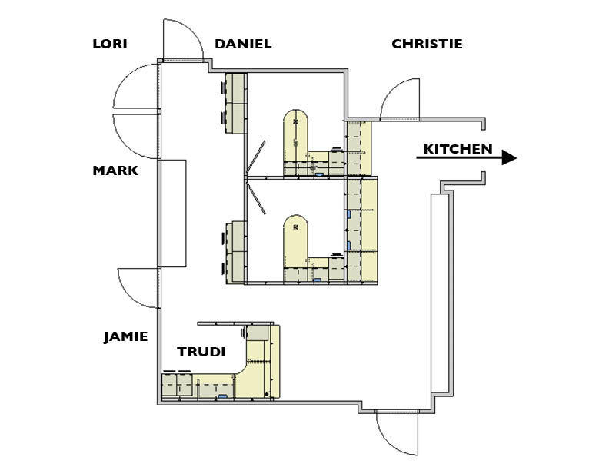
Addition of
Workspaces for
4-H Specialists with extra workspaces on the outside for work projects.

Slide 3
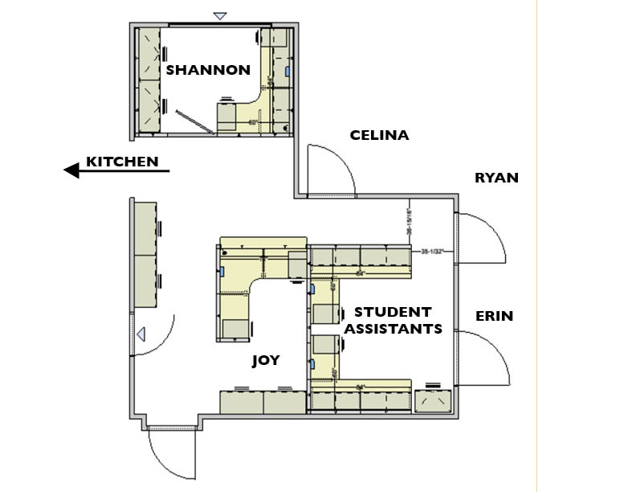
Redesign of Student Assistant Current Workspaces
Student Workspaces Will Move to Other Side of Office
Workspace for
Sandie, Lela, Steve and
Remote Specialists
SANDIE, LELA, STEVE AND REMOTE SPECIALISTS

Slide 4
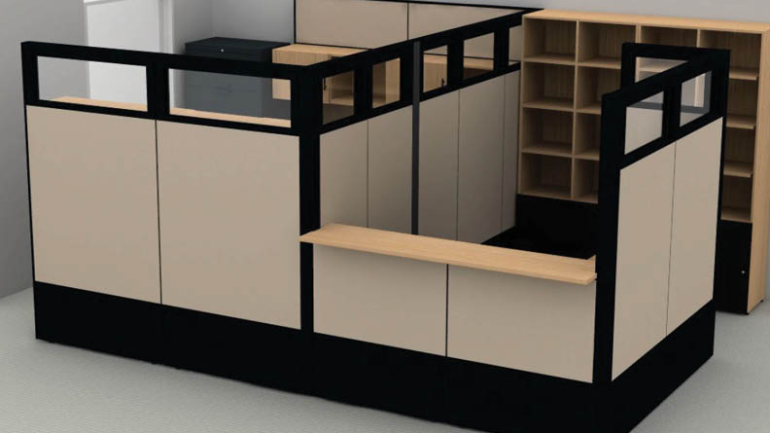

Slide 5
FEATURES:
• Workspace for
three student
workers;
• Additional
workstation (similar
to the one behind
the mailbox areas)

Slide 6
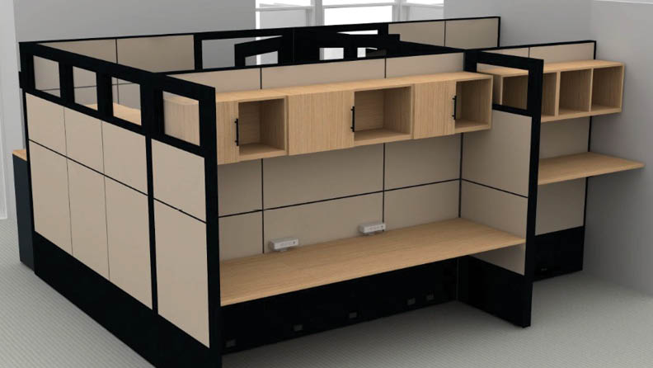

Slide 7
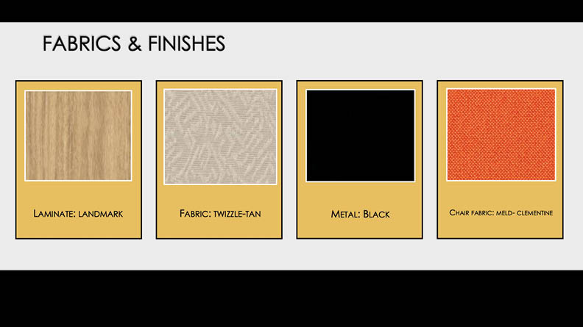
FABRICS and FINISHES …
plus New Wall Paint!

Slide 8
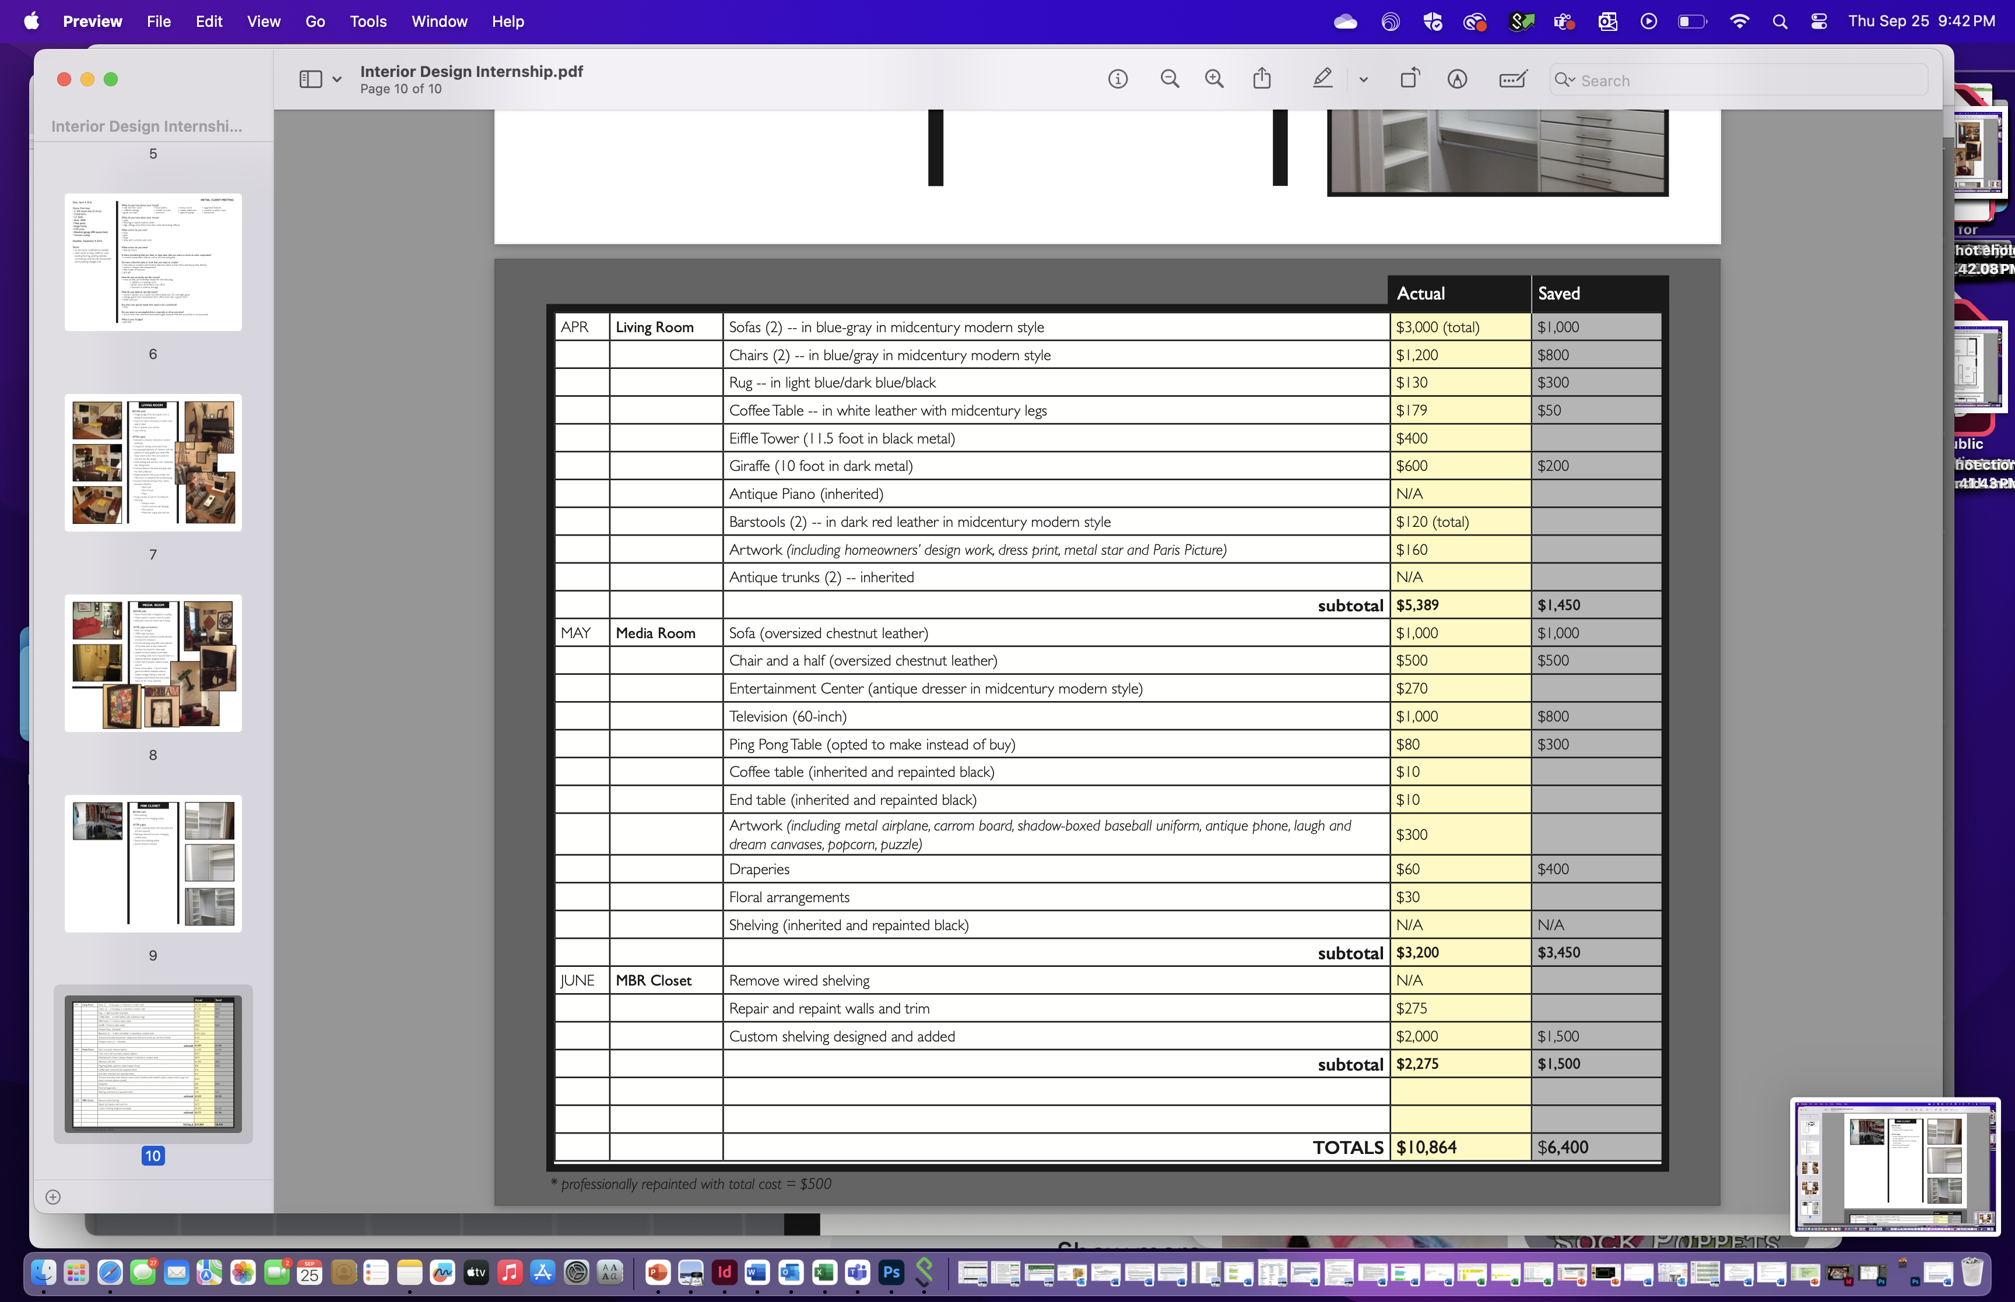
Lorum Upsum 123
2025 Tennessee State 4-H Office
Lorum Upsum 123
Lorum Upsum 123
Lorum Upsum 78910
Lorum Upsum 123
Lorum Upsum x 5
Lorum Upsum 123
Lorum Upsum 123
Lorum Upsum x 20
Lorum Upsum 78910
Lorum Upsum x 2
Lorum Upsum 34578

